Slide 1
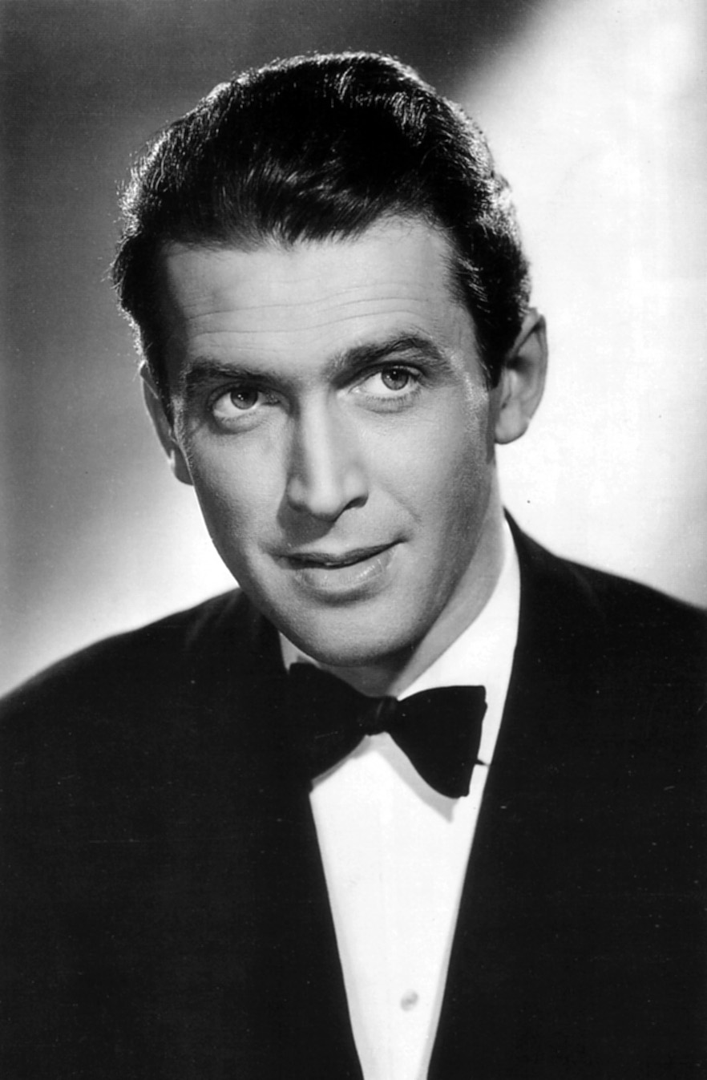
A Short Jimmy Stewart Biography
By Tyler Christiansen

Slide 2
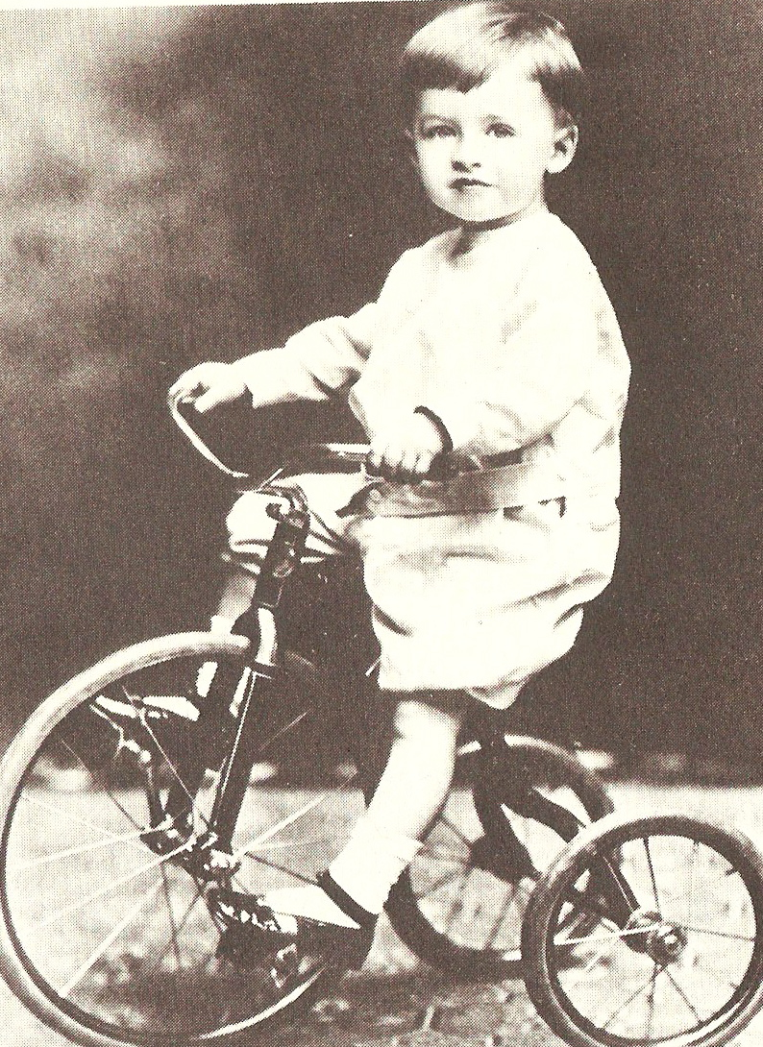
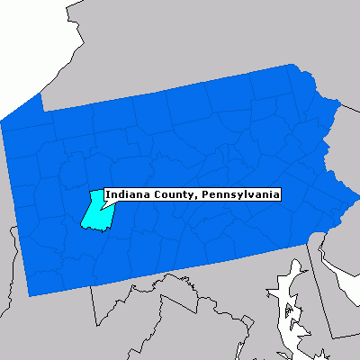
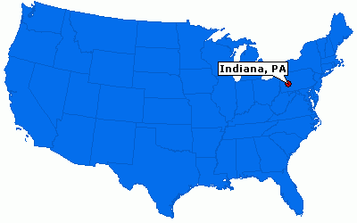
James “Jimmy” Stewart was the first child of Alexander and Elizabeth Jackson Stewart. Jimmy was born on May 20th, 1908 in his parent’s house in Indiana, Pennsylvania.

Slide 3
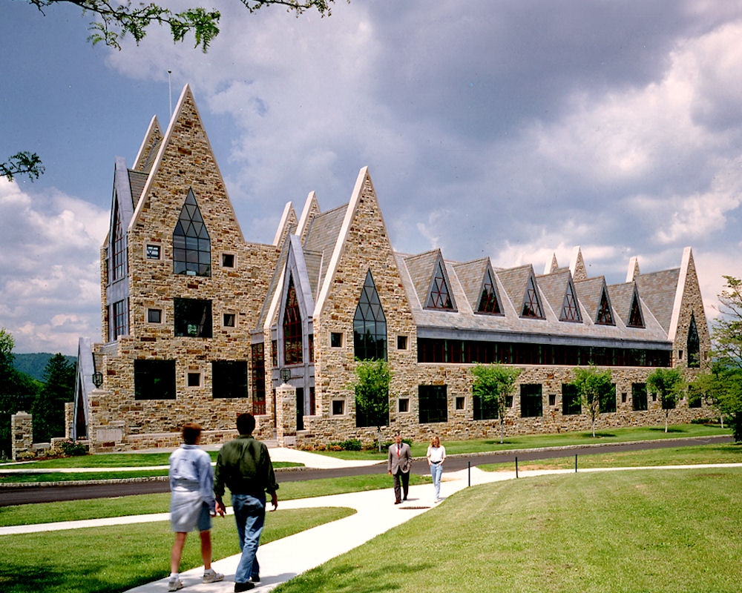
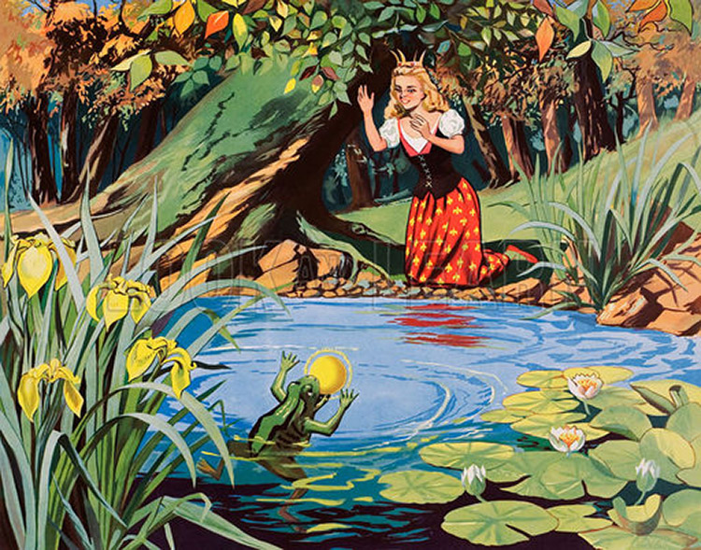
After completing ninth grade, Jimmy went to Mercersburg Academy in Mercersburg, Pennsylvania. At Mercersburg, he got his first role in a stage act. He was in a stage act of the story of The Frog Prince.

Slide 4
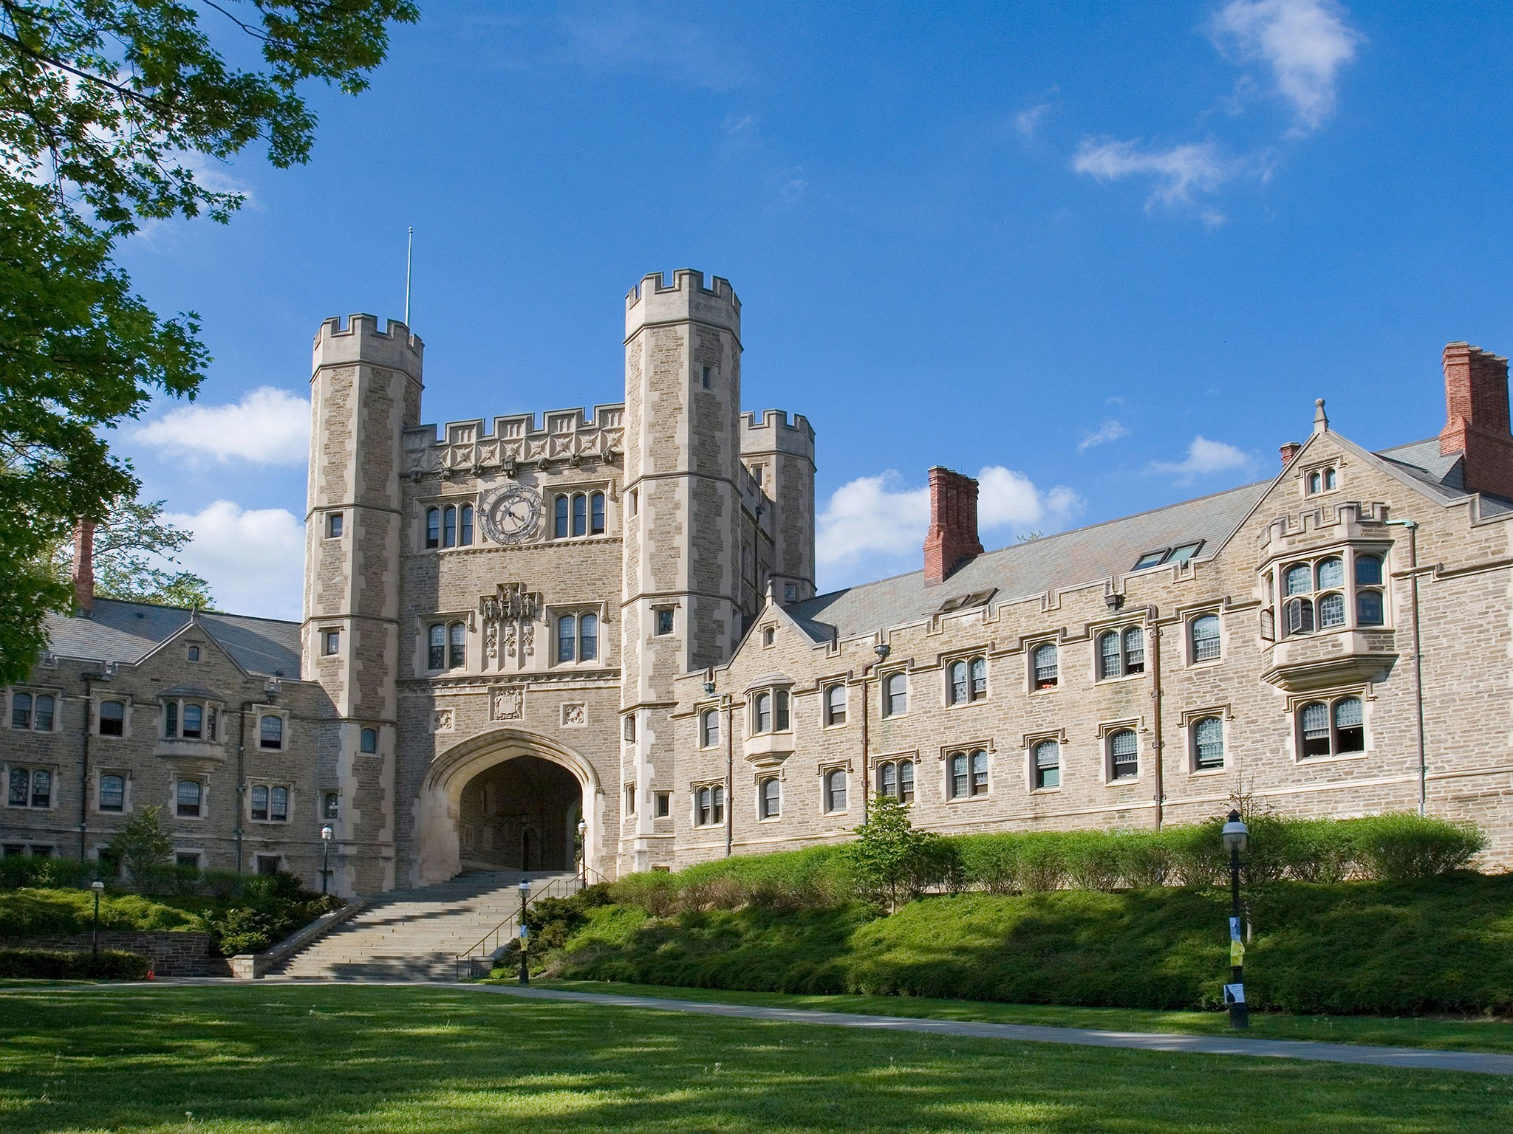

Jimmy graduated from Mercersburg Academy in 1928. That same year in the fall, Jimmy attended Princeton University, where he majored in architecture.

Slide 5
While at Princeton, Jimmy was in a stage production of The Golden Dog. The next year, Jimmy and Josh Logan (who would later be a producer and director) worked together on a production of The Tiger Smiles. Even though Jimmy was involved with performing stage productions, he was planning on going onto graduate school to further study architecture. While they were still at Princeton, Josh Logan once asked Jimmy if he had considered an acting career. Jimmy said "Good God, no! I'm going to be an architect!“. He graduated from Princeton University in 1932.

Slide 6
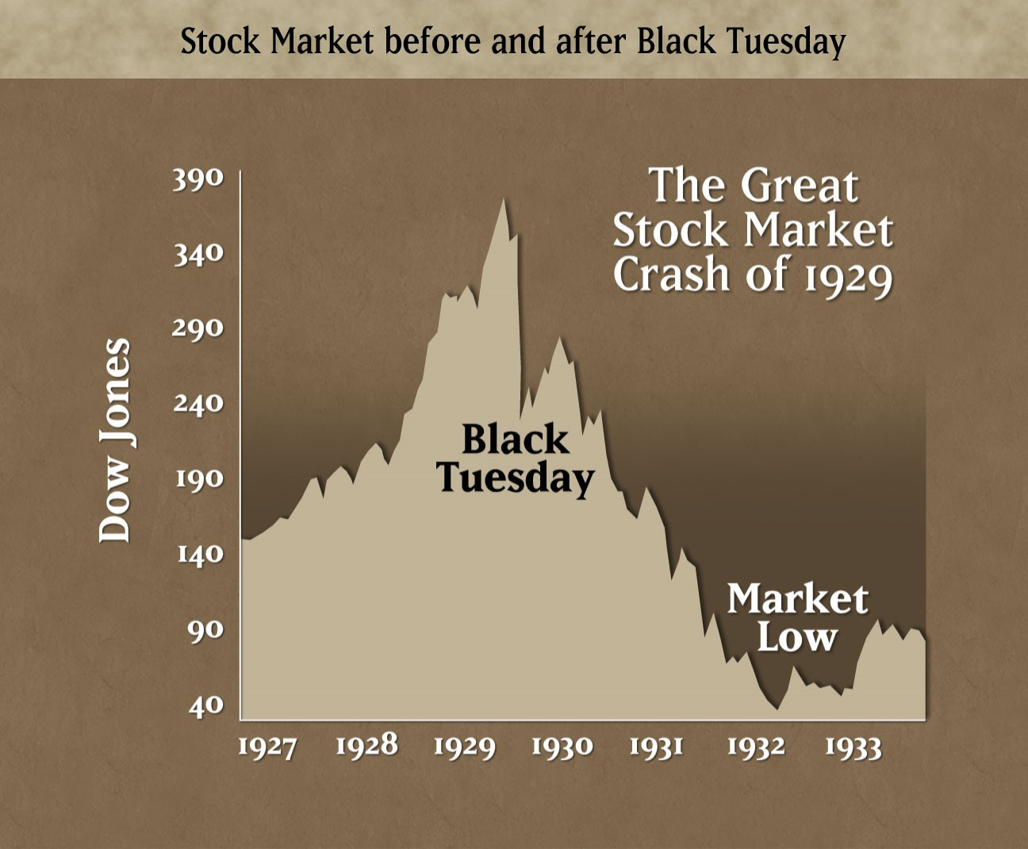
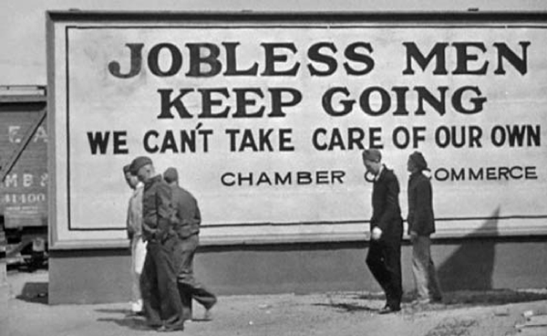
The stock market crash in 1929 and the Great Depression made Jimmy worry about finding work as an architect. After graduating from Princeton, Jimmy went to help his dad Alex with his hardware store during the summer.

Slide 7
Less than two weeks later, Jimmy's friend Josh Logan asked Jimmy to join him and the University Players. The University Players were a summer stock group of actors. Jimmy agreed to join them. Years later Jimmy said "I hadn't seriously considered being an actor, even up to that day I walked across campus en route to get my degree in architecture. I figured I'd go home in the summer and work in my father's hardware store, then go back to school and get my master's degree. That's when I ran into Josh. I suppose it was the most important moment in my life.“ Josh Logan at first had Jimmy do a few minor walk-on parts for stage productions. Jimmy also helped as a stagehand, designed sets, and was learning about how the theatre business worked.

Slide 8
Later that same year, they went on to do stage productions of Carrie Nation on Broadway. Jimmy had several small roles for this production, but it was during this time that critics began to notice Jimmy. After Carrie Nation, Jimmy had roles in Broadway productions of Goodbye Again, Spring in Autumn, and All Good Americans. During these Broadway productions, the critics were giving Jimmy favorable reviews.

Slide 9
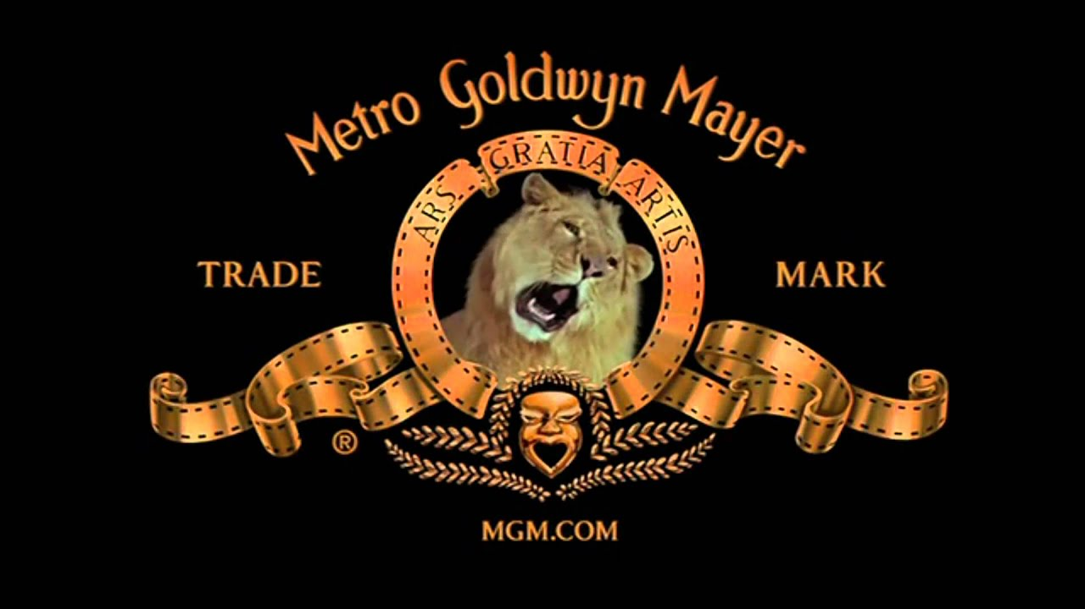
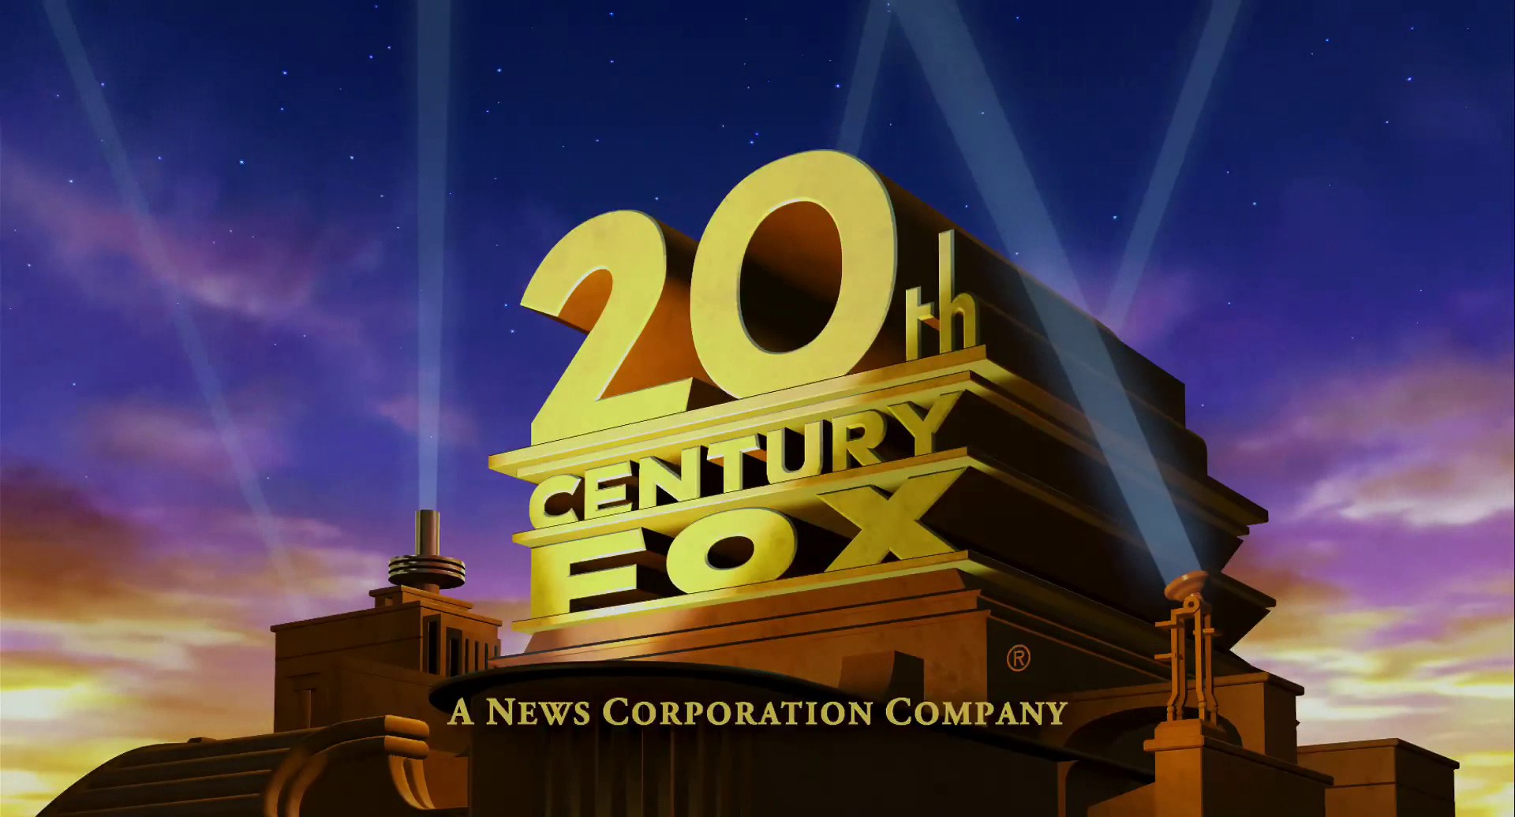
In 1934, Jimmy filled the role of Sgt. O'Hara in Yellow Jack. Jimmy's performance got Metro-Goldwyn-Mayer's (MGM) attention and Jimmy did a screen test with them. Soon after that, Jimmy did a screen test for the FOX movie studio also.

Slide 10
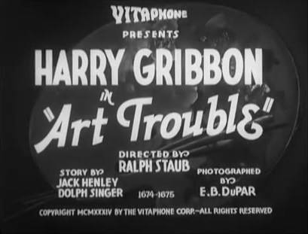
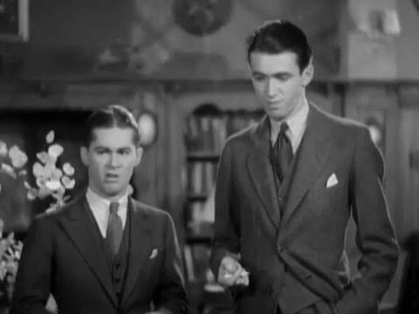
Jimmy was casted in his first movie. A Warner Brothers comedy Art Trouble. After Art Trouble was completed, Warner Brothers and FOX didn't offer Jimmy a contract and he still had not heard back from MGM yet. Jimmy decided to go back to his home town.

Slide 11
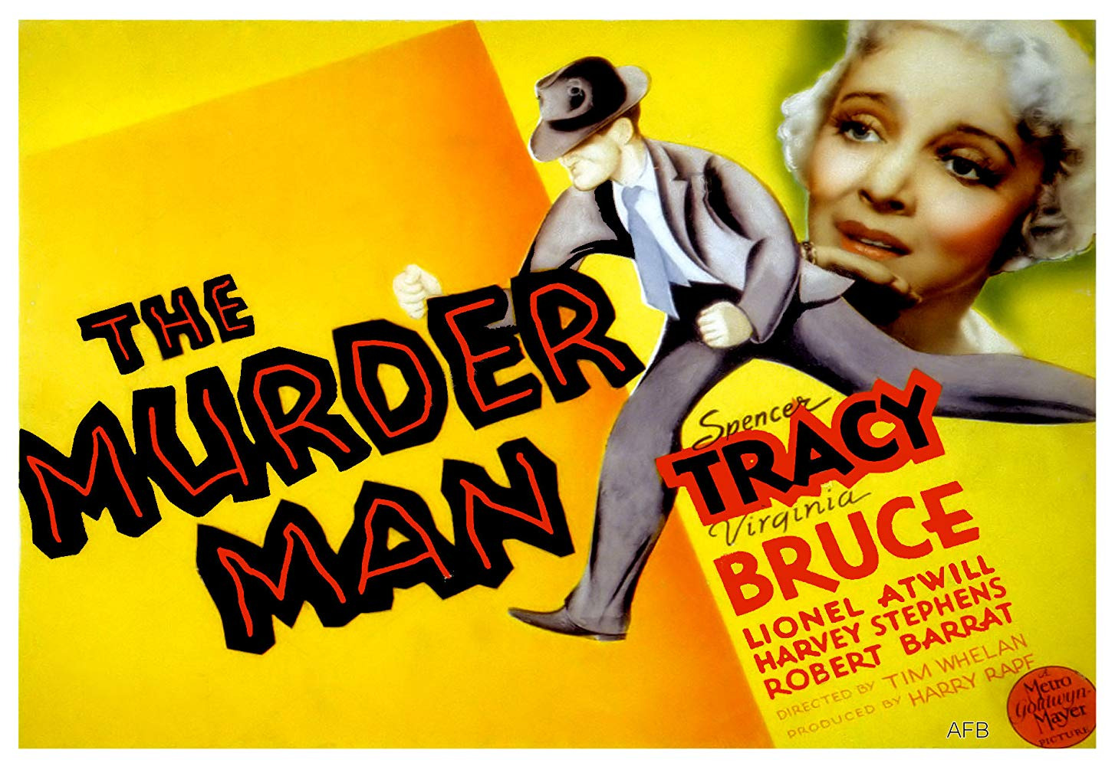
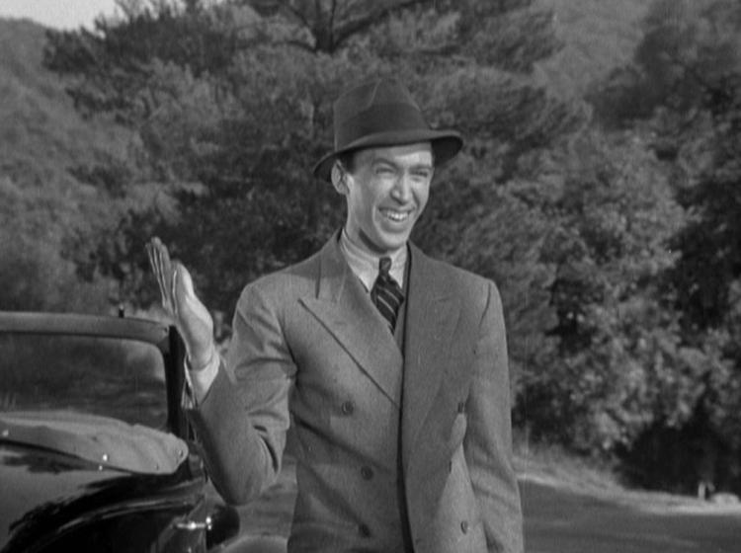
Two months later, MGM called Jimmy and offered him a role in a short film. Jimmy accepted the offer. In 1936, Jimmy had the role of a cub reporter in the short film Important News. Soon MGM gave Jimmy the role of a reporter named Shortie in the movie Murder Man.

Slide 12
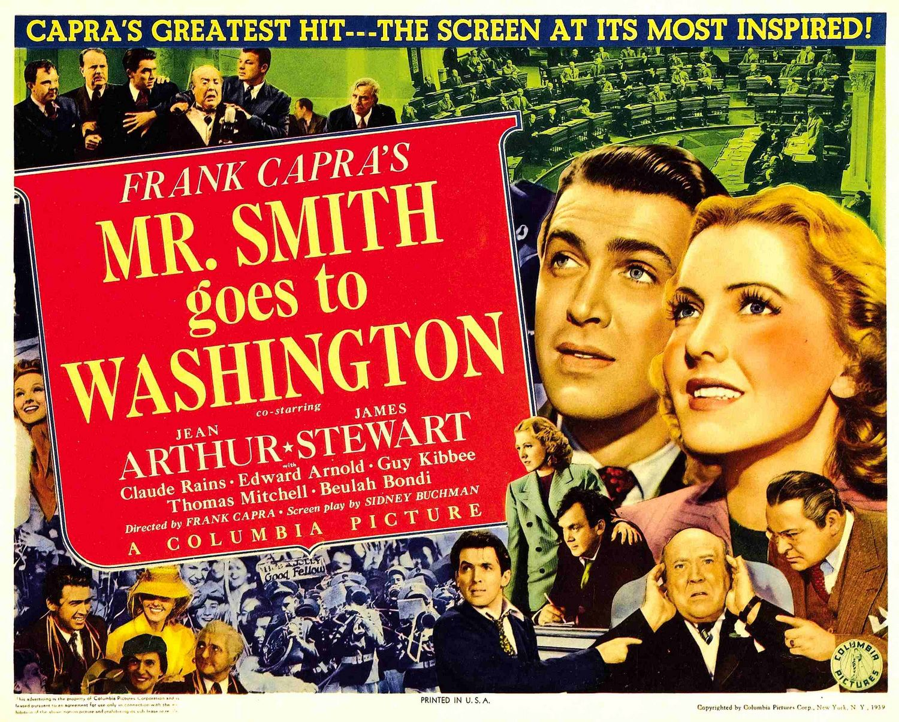
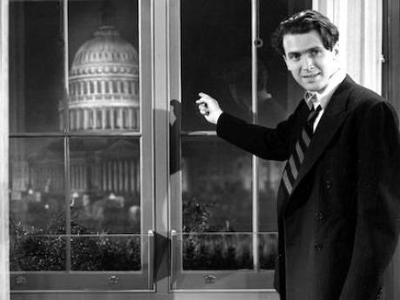
From 1935 to 1939, Jimmy had roles in 29 different movies. In 1939, Jimmy played the main role as Senator Jefferson Smith in the movie Mr. Smith Goes to Washington. This got him his first Academy Award nomination for best actor.

Slide 13
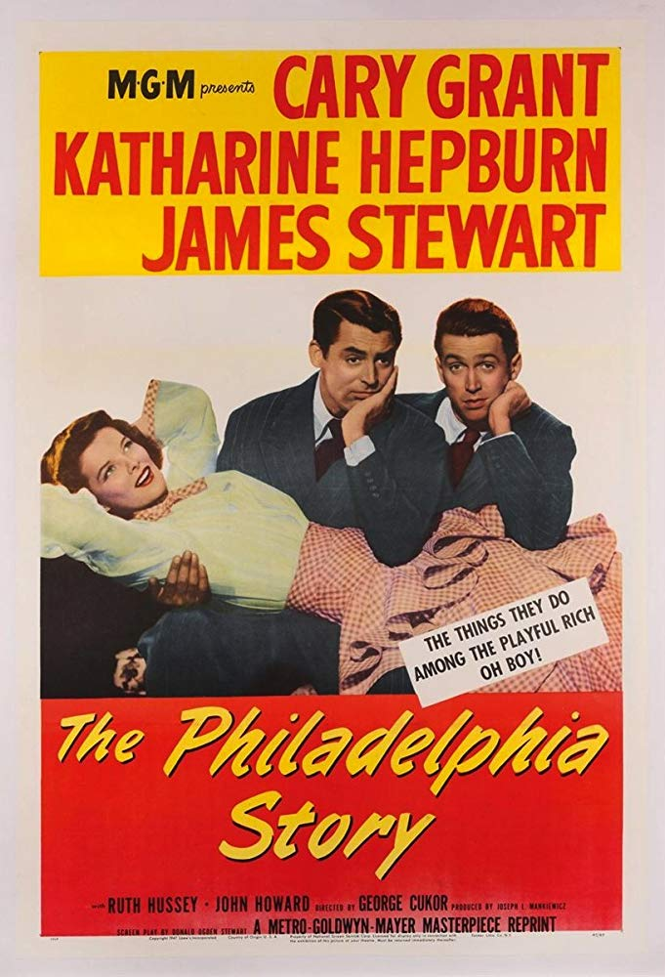
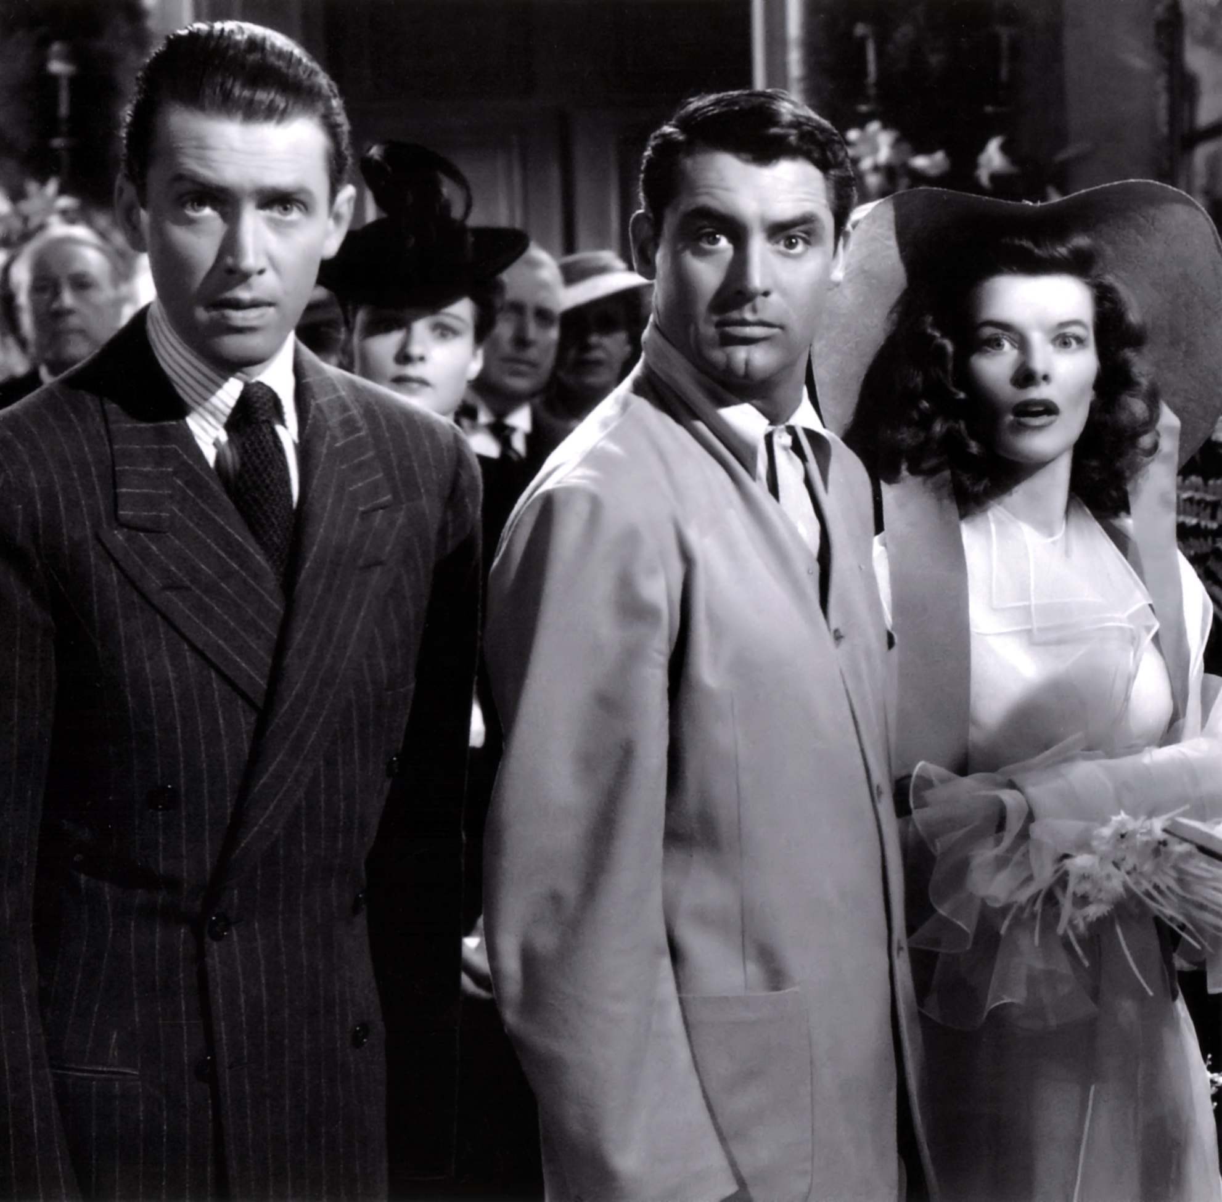
Jimmy had roles in another 9 movies before taking the role of a reporter named Mike Conner in The Philadelphia Story in 1940. This got him his first and only acting Oscar award.

Slide 14
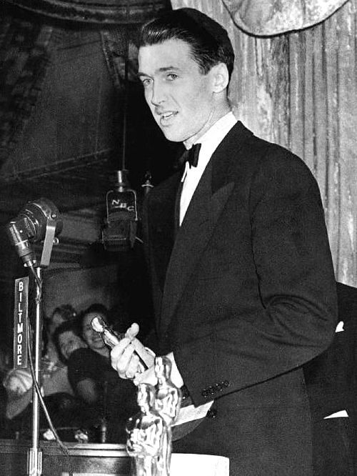
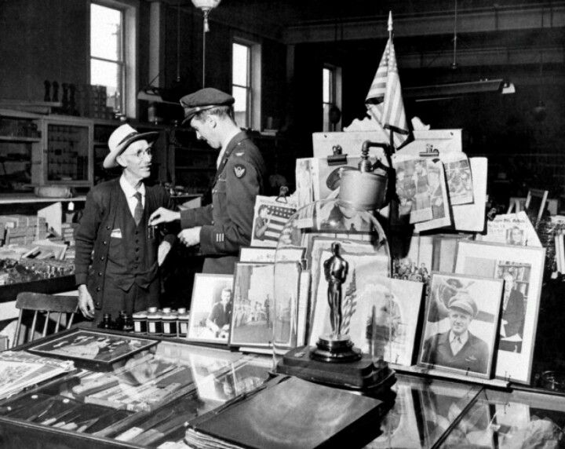
Jimmy sent that award to his father Alex, his father then put it up in the window of his hardware store and it kept it there for 20 years.

Slide 15
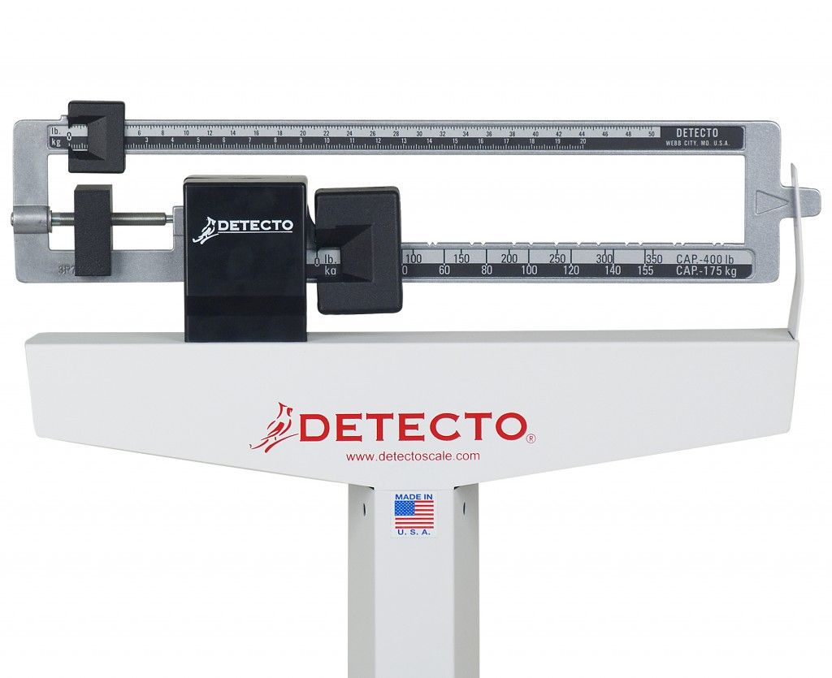
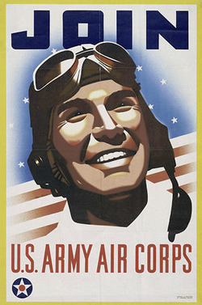
On September 16th of 1940, Congress passed the Selective Service Bill, also known as "the draft". Jimmy was drafted in February of 1941. Jimmy was 5 pounds under the minimum weight requirement for his height. Jimmy wanted to enlist and get into the Army Air Corps and he had only 3 months before he would be too old to enlist into the Army Air Core.

Slide 16
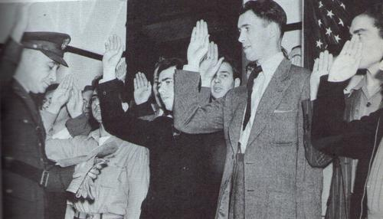
To gain weight, he began to eat spaghetti twice a day along with steaks and milkshakes. Jimmy came back in early March to try to pass again. Jimmy was just 1 ounce short of the minimum weight requirement, but Jimmy talked the doctors into adding a few ounces. In March he got his orders to report for duty just seven days after he got the Academy Award for Best Actor for his performance in The Philadelphia Story.

Slide 17
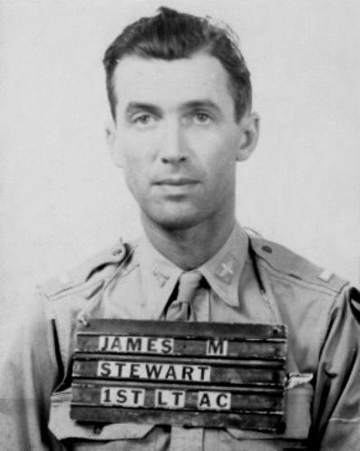
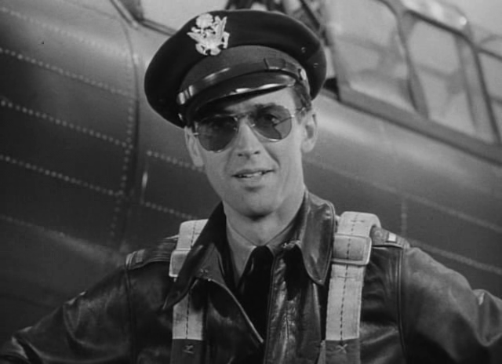
In March of 1941, Jimmy (Private James Stewart) reported to Fort McArthur and was sent to Moffett Field. Even though he was an experienced pilot, the Army Air Corps required that Jimmy had to get another 100 flying hours. Jimmy used a nearby airfield to get his 100 hours of flight time. In January of 1942, Jimmy was commissioned a 2nd Lieutenant. The military had Jimmy do narrations for military training films, radio shows, and travel with war bond tours. At heart though, Jimmy didn't want to do this. He wanted more flight time and requested it.

Slide 18
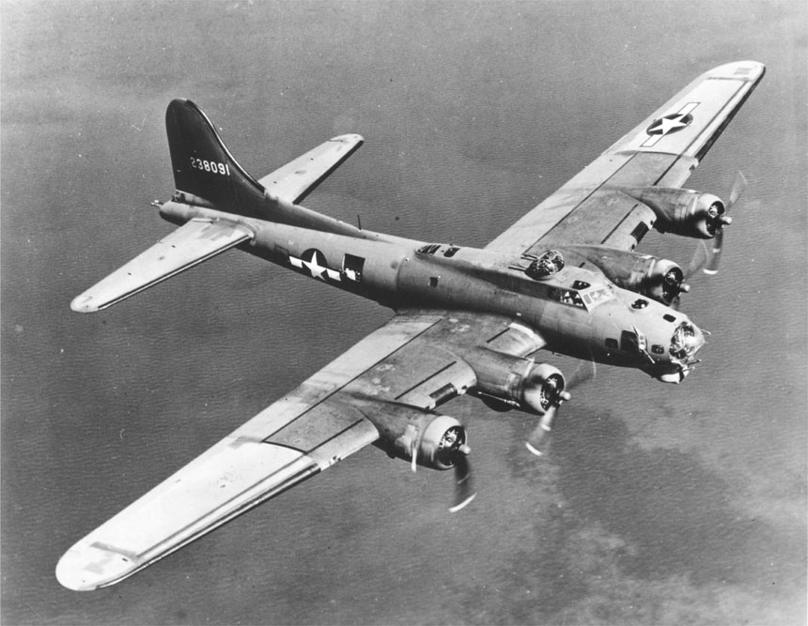
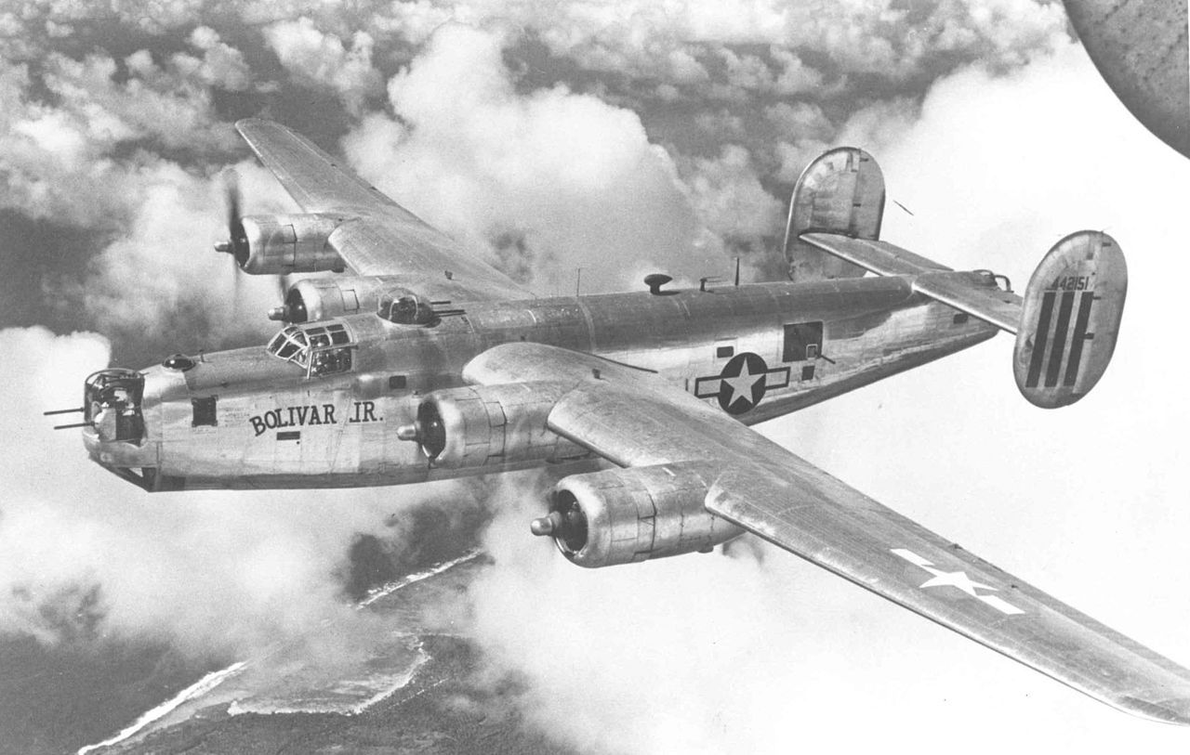
Jimmy went through training on how to fly bomber planes and four-engine planes. Jimmy had two assignments instructing pilots in training. Next Jimmy was given an administrative assignment, which he didn’t like and requested a transfer. He was assigned as an Operations Officer, three weeks later he was reassigned as Squadron Commander. Shortly afterwards he was promoted to Captain. On November 11th 1943, Jimmy was transferred overseas.

Slide 19
Jimmy flew in 20 combat missions before being reassigned as an Operations Officer in early 1945. In April Jimmy was promoted to Colonel and was reassigned as Chief of Staff. For his combat missions, Jimmy was awarded 3 Distinguished Flying Crosses, 4 Air Medals, and the French Croix de Guerre. After World War 2, Jimmy transferred to the US Air Force Reserves.

